Slide 1
91896 & 91897 Documentation
Link to working program:
https://github.com/chay69199/Recipe_cost_calculator
(see 08_final_assemble.py)
Links to trello board / project management tools (eg: GIST):
https://trello.com/b/JdPncWG4/a-recipe-cost-calculator

Slide 2
Relevant Implications – Functionality
Functionality involves ensuring that the program works as expected. It should work for expected, boundary and unexpected cases. Functionality matters because if a program does crashes or gives incorrect output users will become frustrated. Programs that don't work correctly are of limited use and in real life, if a program does not function it could cause users harm and / or damage the reputation of the developer.
The functionality in my program is shown by the correct output when I doing the test. For example, my program asks the user to input the unit of the ingredients. The user should input g or kg. It also accept the user to input the uppercase G or KG/Kg. The input “Blank”, any Numbers and any other Strings or Symbol such as “5.3”,“meter” or “!” is invalid. The program should not crash when the input is invalid and should instruct the user for a valid input.
Notes:
Explain the relevant implications here. Then as you work, develop your code, discuss how the implications are being met.

Slide 3
Relevant Implications – Usability
Usability is about how easily the end user can accomplish tasks. It deals with issues like making instructions and error messages clear and easy for users to understand. Usability matters because if a program is hard to use people will get frustrated and give up. This could result in the program not being used / bought (and the developer would lose money).
In my program, it has a clear instruction to show how to use the program. A clear indication on what should be input and display the valid input. If the input is invalid, the program always gives clear information on what should be input.
Notes:
Explain the relevant implications here. Then as you work, develop your code, discuss how the implications are being met.

Slide 4
Relevant Implications – Aesthetics
Aesthetics involves an outcome's overall appearance. A program which has well spaced instructions, prompts and 'decoration' around key messages is more aesthetically pleasing that a program composed of unspaced, plain text. Aesthetics matters because users prefer interfaces which are attractive over those that are plain / boring.
In my program, for each section, I added a few lines of “**************” with the title to separated it. In each section, I also added a few empty line between each input and output result make it looks clear and tidy. I want to ensure the users feel easy and happy to read the outcome by doing this.
Notes:
Explain the relevant implications here. Then as you work, develop your code, discuss how the implications are being met.

Slide 5
Relevant Implications - social
The social implications of an outcome involve how it affects users, the wider community and society as a whole. The social implications matter because if they are not considered and addressed, an outcome could have unintended consequence
For example, the function of my program is to calculate the cost of the recipe.
It is possible for some recipe that might not be healthy, but the cost is very low. The user may prefer this kind of recipe just because of its cost.
Or, if the user is the owner of a restaurant, for a same recipe with different quality ingredients, the cost may be lower, and the business owner would prefer this regardless the quality of the food.
In my last version of program, I added a notification after the calculated cost show that the user should have a healthy diet lifestyle with the high-quality food.
Notes:
Explain the relevant implications here. Then as you work, develop your code, discuss how the implications are being met.

Slide 6
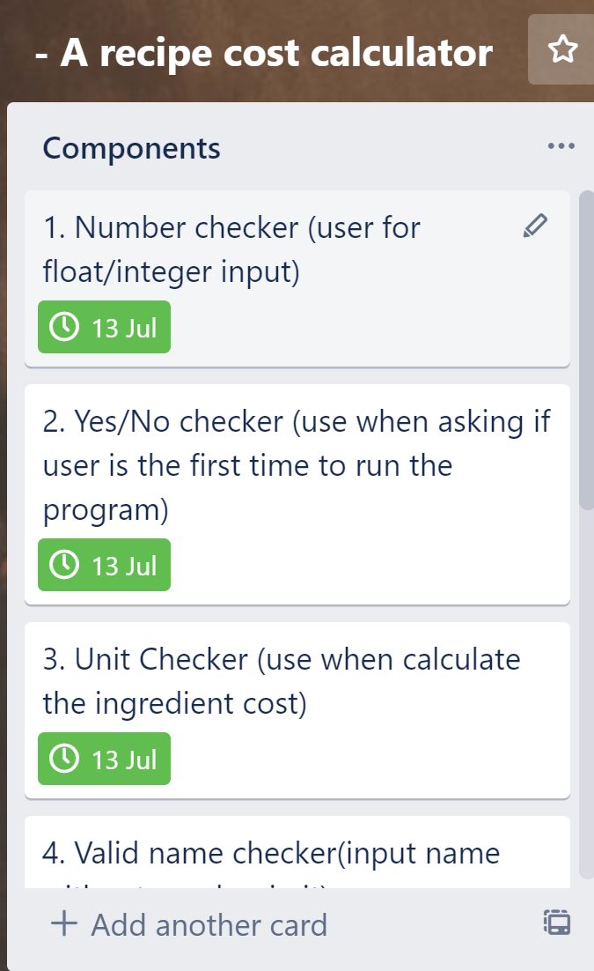
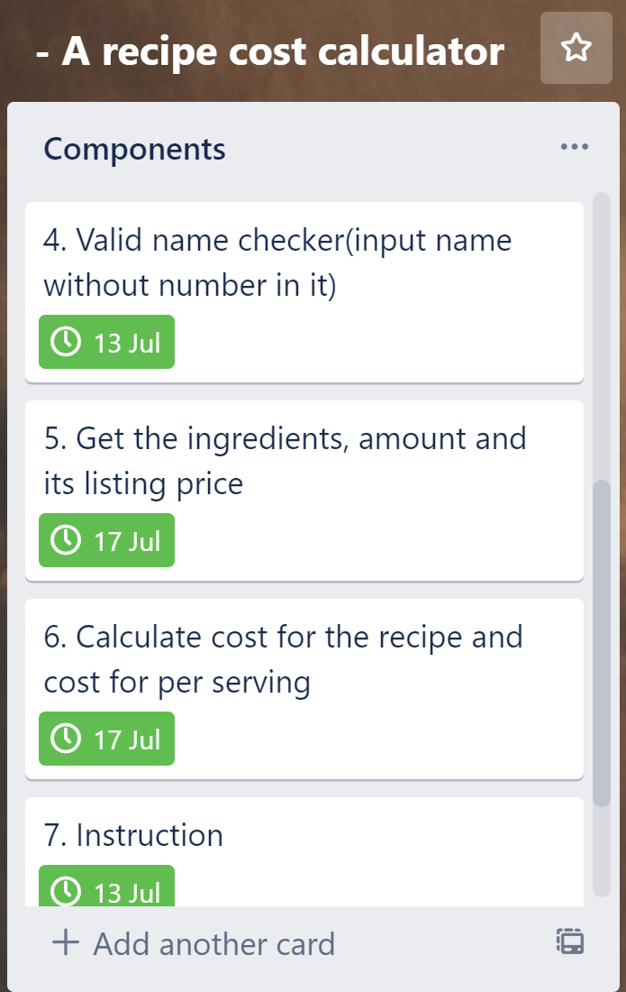
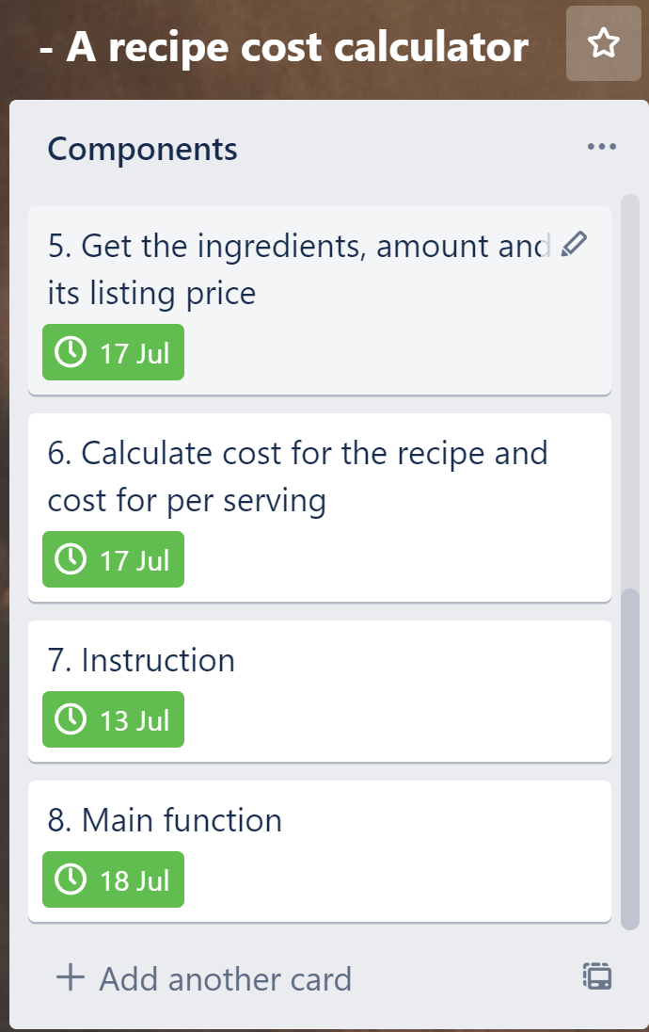
Decomposition
Notes:
Paste screenshots of your initial Trello board / task decomposition on this slide. If you have a long list, you might need to break it up into several columns. Delete this instruction when you are done.

Slide 7
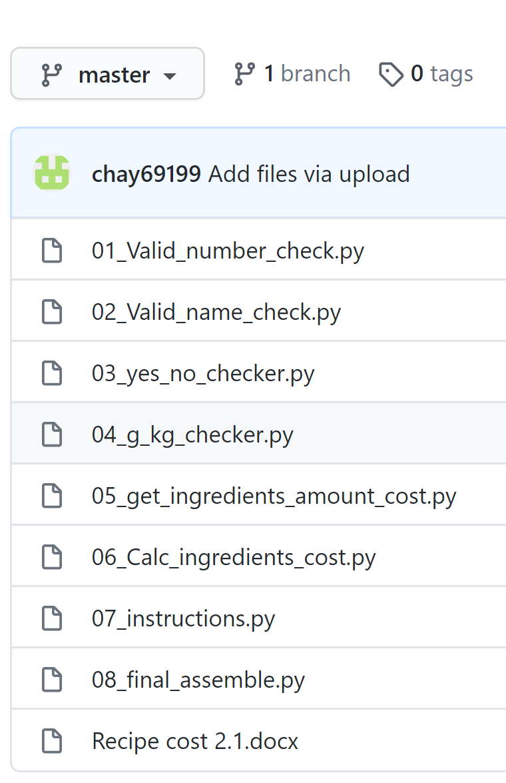
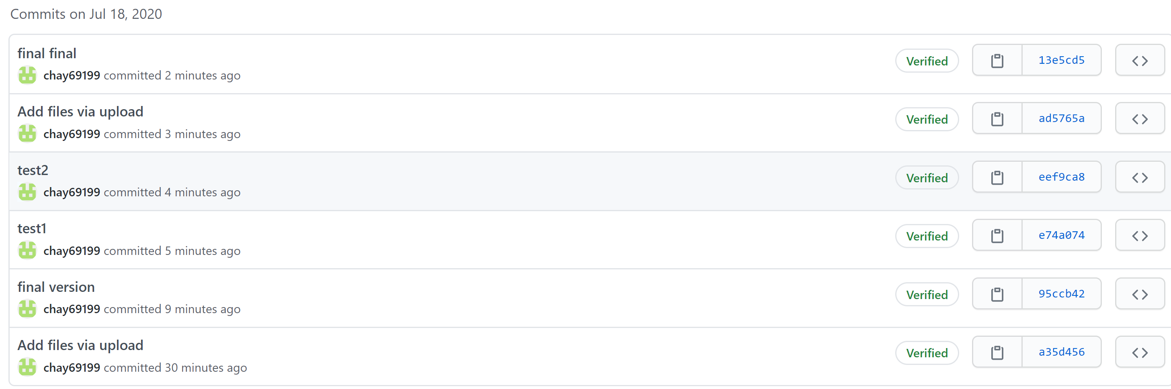
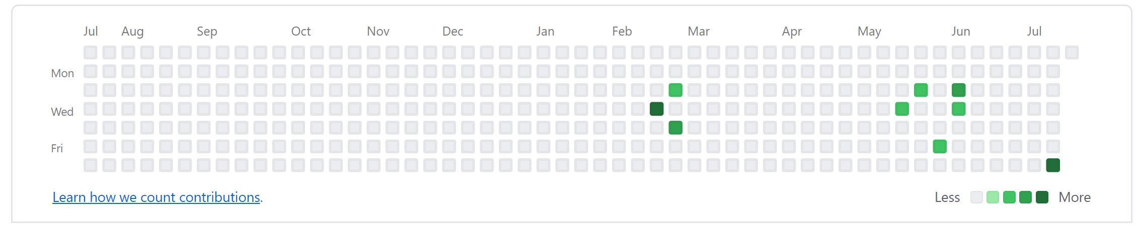
Version Control Evidence
Idealy, I should use github as my version control system and routinely committed code to that platform. However, I am not always having network access. I also have to control the version of my code at local hard disc by assign different version name. when I have the network access and I commit the code the GitHub platform.
Version on GitHub

Slide 8
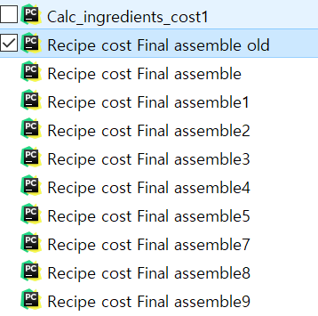
Version Control Evidence
Idealy, I should use github as my version control system and routinely committed code to that platform. However, I am not always having network access. I also have to control the version of my code at local hard disc by assign different version name. when I have the network access and I commit the code the GitHub platform.
Different version of code on the local disc by assign version name

Slide 9
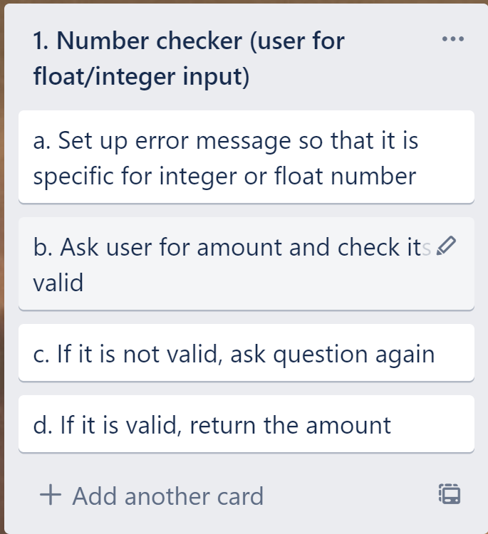

Slide 10
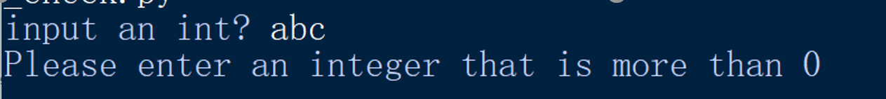
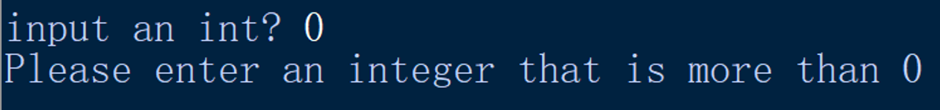
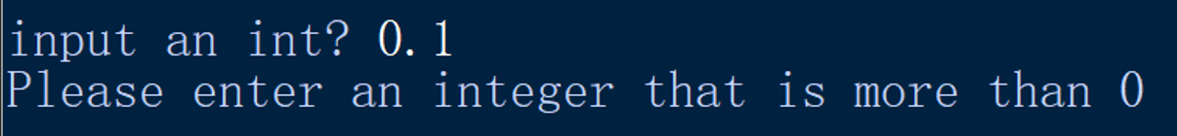
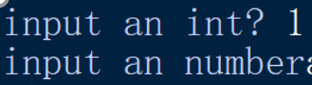
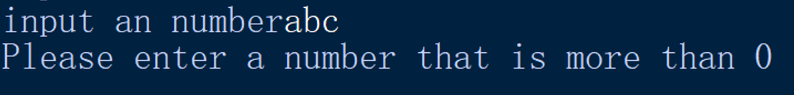
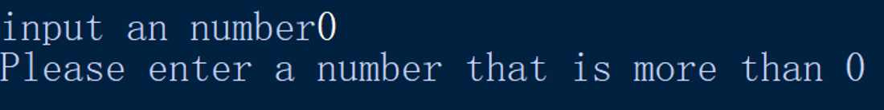
Number Checking Function Testing...
# of items (must be first integer > 0, then a float number >0)
abc → Please enter an integer that is more than 0
0 → Please enter a number that is more than 0
0.1 → Please enter an integer that is more than 0
1 → Program continues, ask for input float
abc → Please enter a number that is more than 0
0 → Please enter a number that is more than 0
0.1 → Program continues, print both int and float input

Slide 11
Number checker - Trialling Notes
Originally my number checker was recycled from Fund_Raising_Calculator.
01_num_check.py
I modified the main function in this file to test it. It will ask the user to input an integer larger than 0 first. If the input is correct, it will ask the user to input a number larger than 0. If the second input is correct, input integer and input number will be printed out.

Slide 12
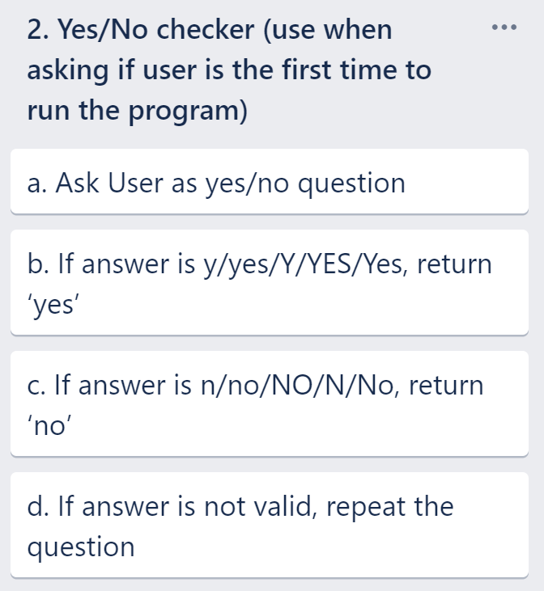

Slide 13
2. Yes / No Checker (Test Plan)
Test Case | Expected Values | Test Case | Expected Values
Please input? y | You said ‘yes’ | Please input? n | You said ‘no’
Please input? yes | You said ‘yes’ | Please input? no | You said ‘no’
Please input? Y | You said ‘yes’ | Please input? N | You said ‘no’
Please input? YES | You said ‘yes’ | Please input? No | You said ‘no’
Please input? Yes | You said ‘yes’ | Please input? NO | You said ‘no’
Please input? maybe | Please enter yes / no <question repeats>

Slide 14
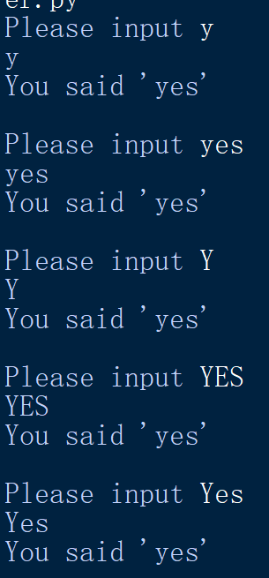
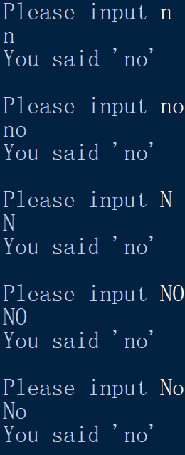
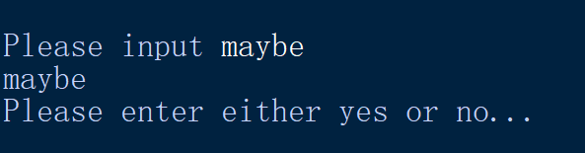
2. Yes / No Checker (Testing)
Valid ‘y’
(single letter, lowercase)
Valid ‘n’
(single letter, lowercase)
Valid ‘yes’
(all lowercase)
Valid ‘no’
(all lowercase)
Valid ‘y’
(single letter, uppercase)
Valid ‘N’
(single letter, uppercase)
Valid ‘YES’
(all uppercase)
Valid ‘No’
(all uppercase)
Valid ‘Yes’
(Uppercase and Lowercase)
Valid ‘No’
(Uppercase and Lowercase)
Invalid, question repeats.

Slide 15
2. Yes / No Checker - Trialling Notes
My first function, recycled from Fund_Raising_calculator.
I found when inputing all uppercase or upper-lower case combined, the output is not the same as all lower case input or single letter input.
I found it is cased by if response.lower() == item: return response. Response is the same as input. I modified the return to response.lower() to return the lower case of the input, making the return uniform no matter how to input.
I also modify the main function to test this function

Slide 16
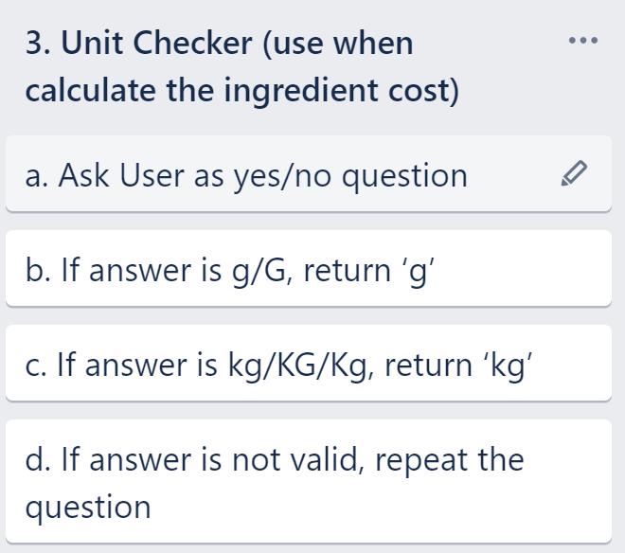

Slide 17
3. Unit Checker (Test Plan)
Test Case | Expected Values
Please input? g | You said ‘g’
Please input? G | You said ‘g’
Please input? kg | You said ‘kg’
Please input? KG | You said ‘kg’
Please input? Kg | You said ‘kg’
Please input? Meter | Please enter g / kg <question repeats>
Please input? 5.3 | Please enter g / kg <question repeats>
Please input? ! | Please enter g / kg <question repeats>
Please input? Blank | Please enter g / kg <question repeats>

Slide 18
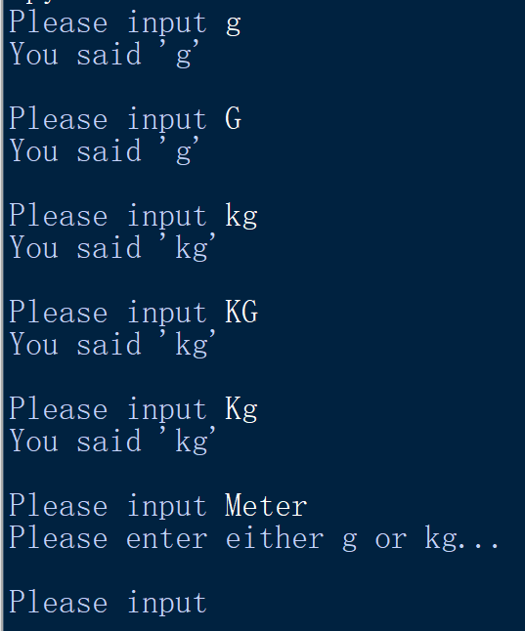
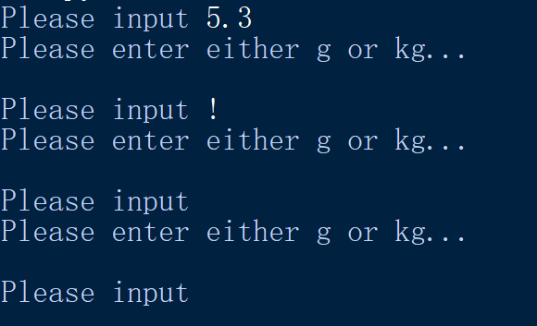
3. Unit Checker (Testing)
Valid ‘g’ (lowercase)
Valid ‘G’ (uppercase)
Valid ‘kg’ (lowercase)
Valid ‘Kg’ (uppercase)
Valid ‘Kg’
(Lowercase and uppercase)
Invalid, question repeats.

Slide 19
3. Unit Checker (Testing)
Invalid, question repeats.

Slide 20
3. Unit Checker - Trialling Notes
My first function, is still recycled from Fund_Raising_calculator, yes_no checker
This function is to ask user input the unit of the ingredient both in the recepi and found in the supermarket
The return value is all the lowercase of the input as this need to be used in the further cost calculation.
I also modify the main function to test this function

Slide 21
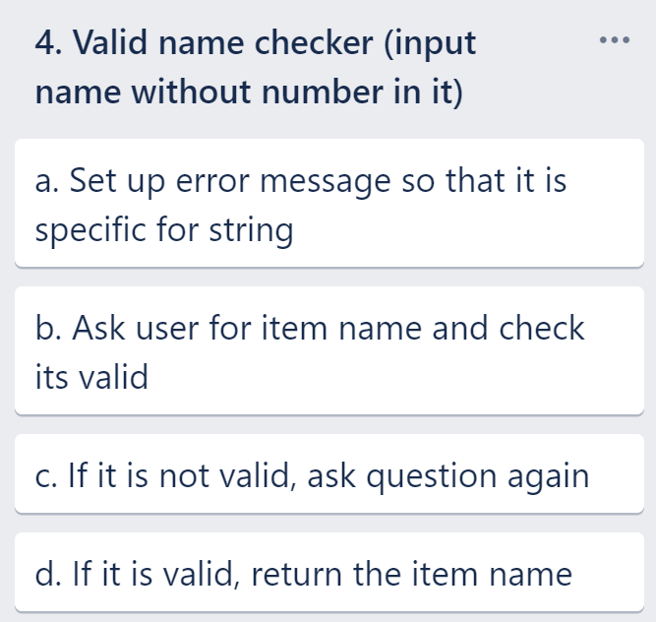

Slide 22
4. Valid name checker (Test Plan)
Test Case | Expected Values
blank | Sorry, this can't be blank
sushi4 | your input has numbers in it
sushi | Your input name is sushi, your input is good
Sushi | Your input name is Sushi, your input is good
SUSHI | Your input name is SUSHI, your input is good

Slide 23
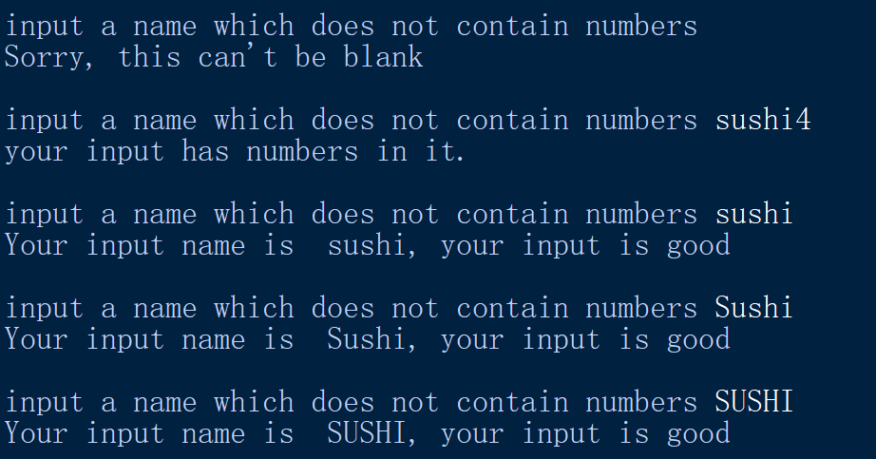
4. Valid name checker(Testing)
Can not be blank
Has number in it ask for reinput
All lowercase input is good
Lowercase and uppercase, input is good
All uppercase, input is good

Slide 24
4. Valid namer checker - Trialling Notes
This function is orrginally recycled from recipe_modernizer
I modify the main function. It input can be a loop just for a more convenient test

Slide 25
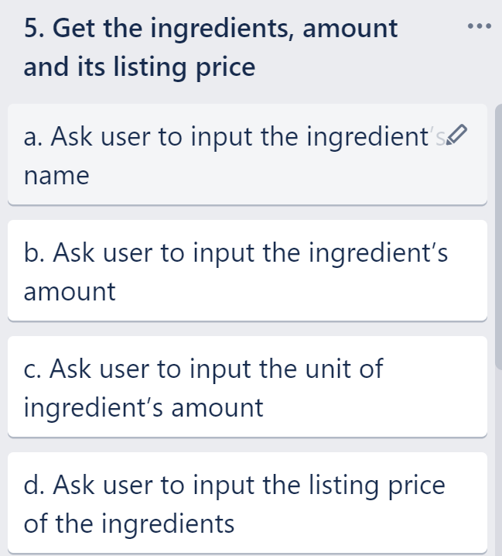

Slide 26
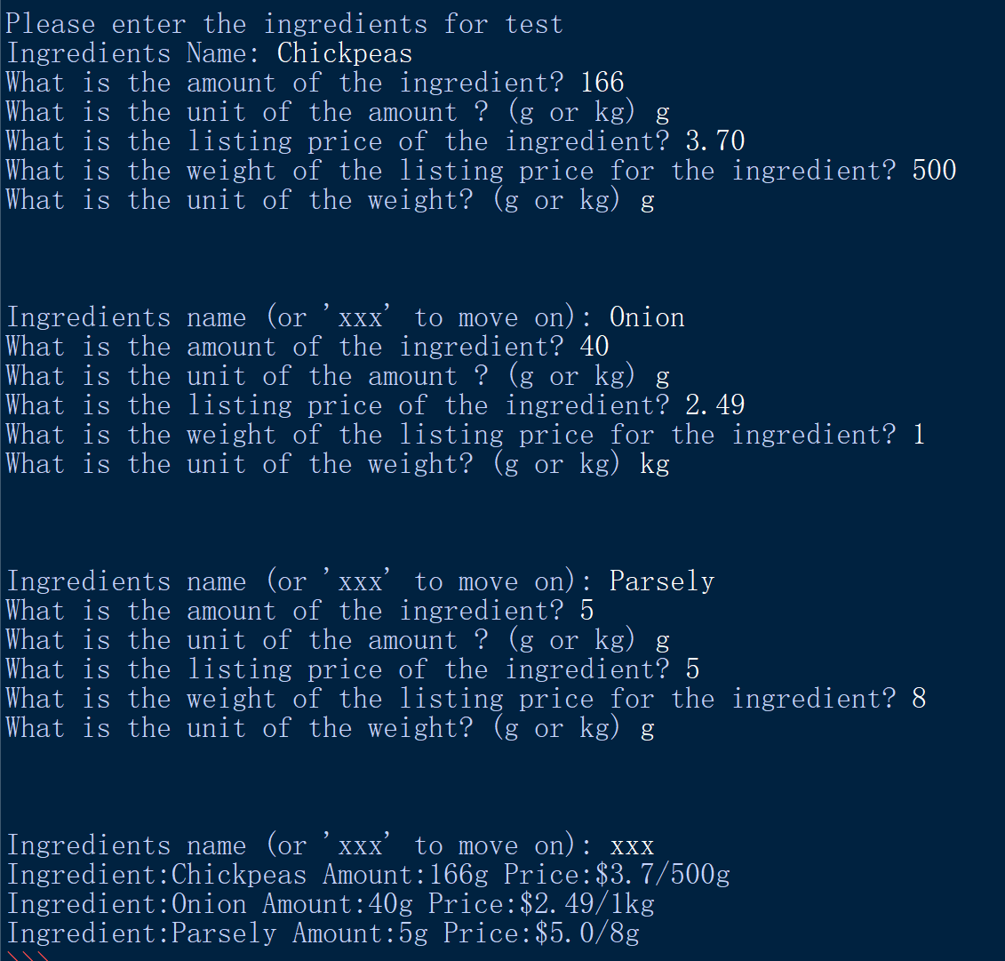
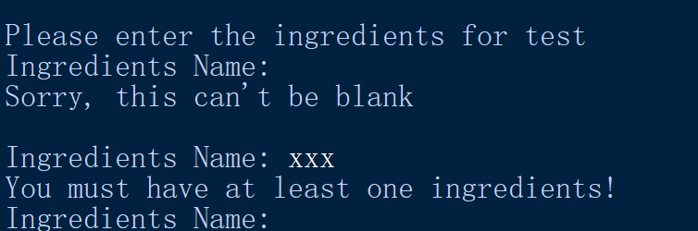
5. Get the ingredients, amount and its listing price (Test Plan/testing)
At least one ingredients must be input
Recipe Ingredients |  |  | Ingredient Price
Amount | Unit | Ingredient | Price | Amount | Unit
166 | g | Chickpeas | 3.70 | 500 | g
40 | g | Onion | 2.49 | 1 | kg
5 | g | Parsely | 5.00 | 8 | g

Slide 27
5. Get the ingredients, amount and its listing price - Trialling Notes
This function is partially recycled from this function 03_Variable_costs of Fund_Raising_Calculator
This function is used to get the ingredients name amount listing price and the weight for that listing price. Then this information need to be used for calculating the cost of each ingredient and total cost of the recipe.
After getting all the ingredient information, it should print out a list so the user could have a better insight of the information of the ingredient.

Slide 28
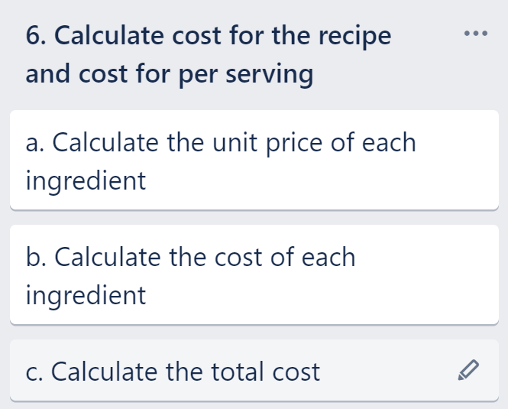

Slide 29
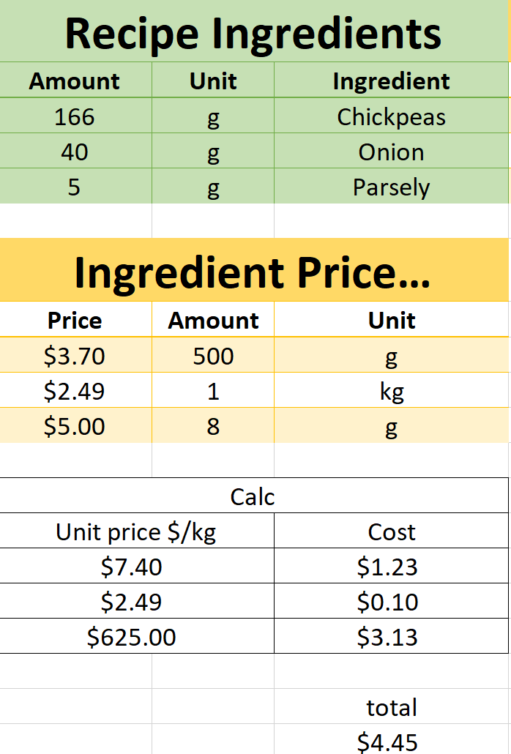
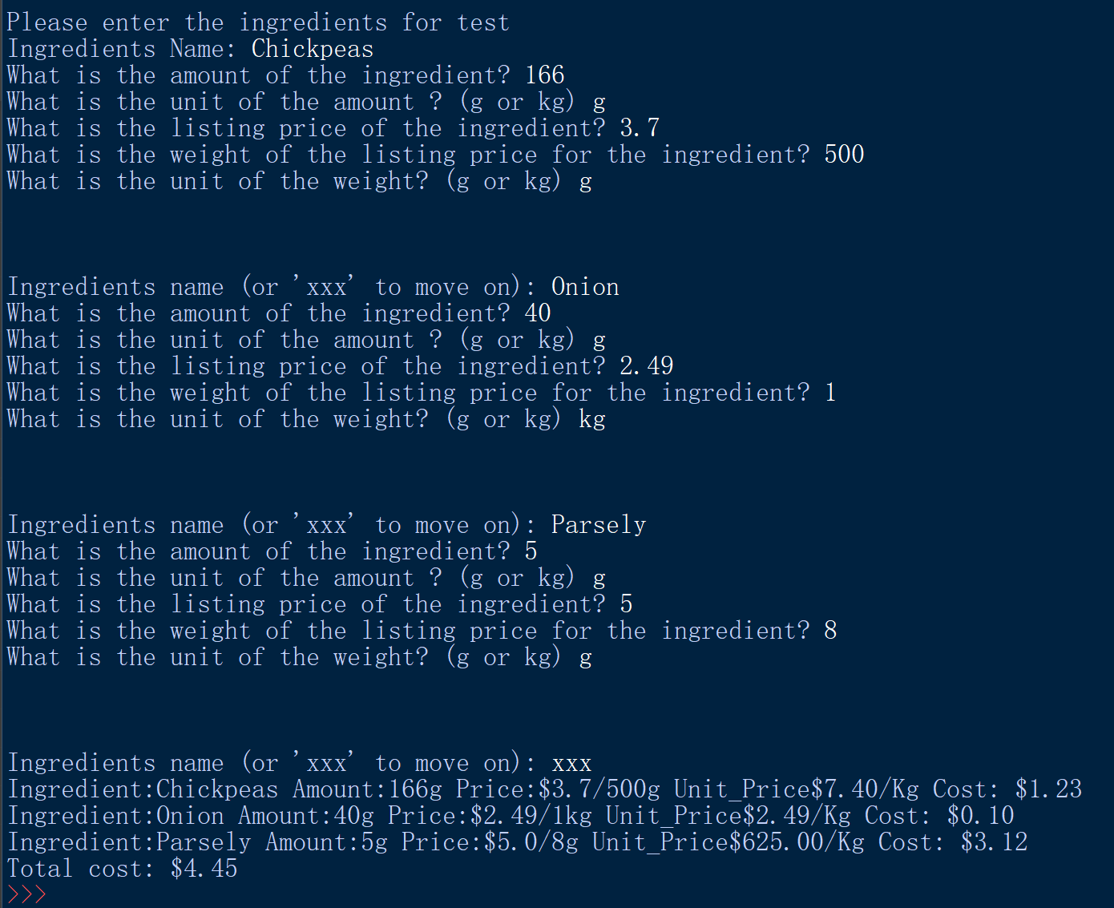
6. Calculate cost for the recipe (Test Plan/testing)

Slide 30
6. Calculate cost for the recipe - Trialling Notes
I originally have this calculation in the main function but later I think if make this as a separate function will make the main function looks more tidy
This function is to used the input recipe and ingredient information to calculate the cost for each ingredient and the total cost
I use local file name to do the version control when I don’t have the network access and also use the github as the version control when I have the network access. There are different version for the main function and this function

Slide 31
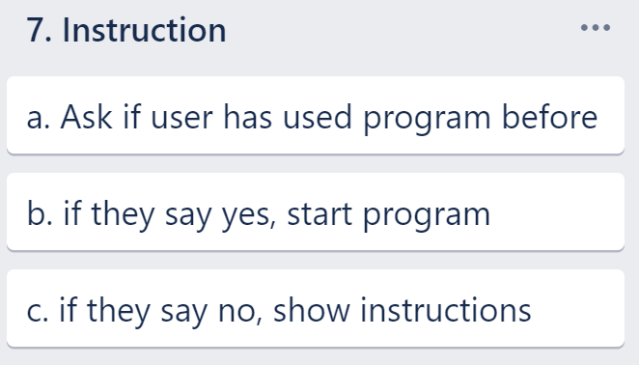

Slide 32
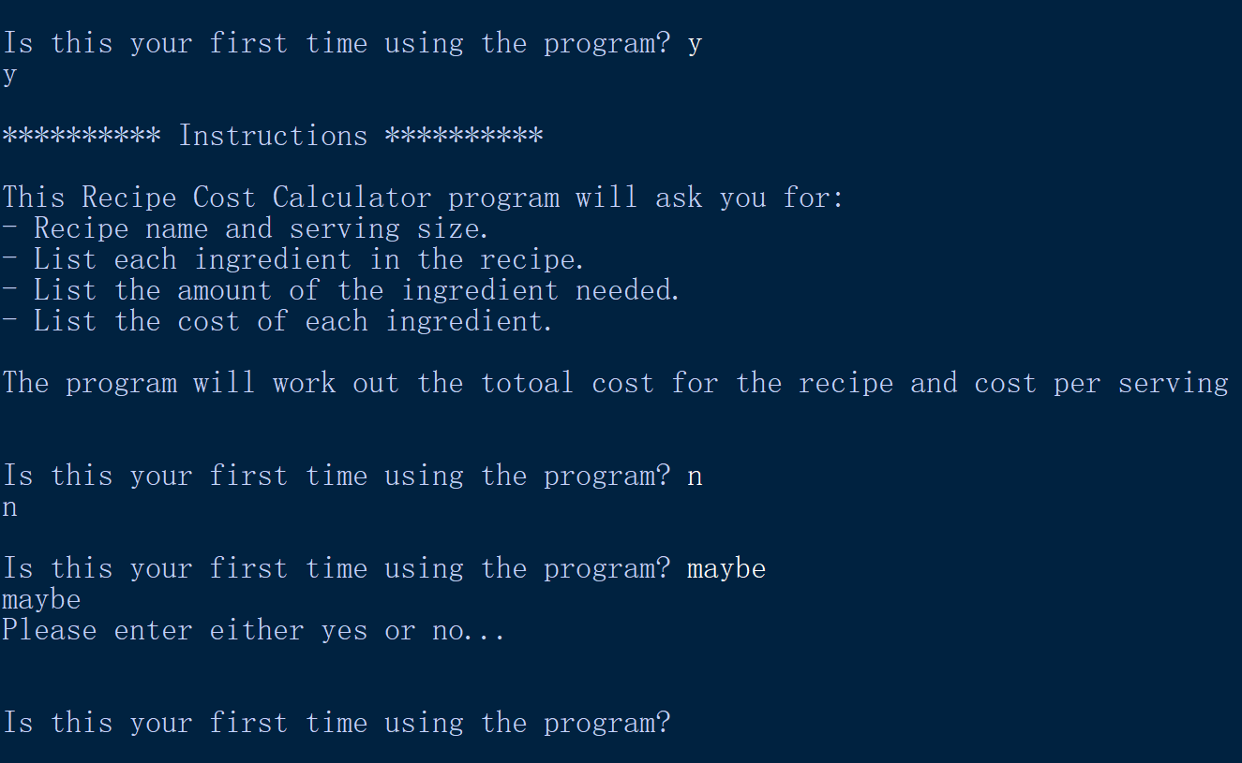
7. Instructions - Testing / Test Plan
Test Case | Expected
First time? yes | Program launches (instructions displayed)
First time? no | Instructions don’t display
First time? maybe | Enter either yes or no(Question repeats)

Slide 33
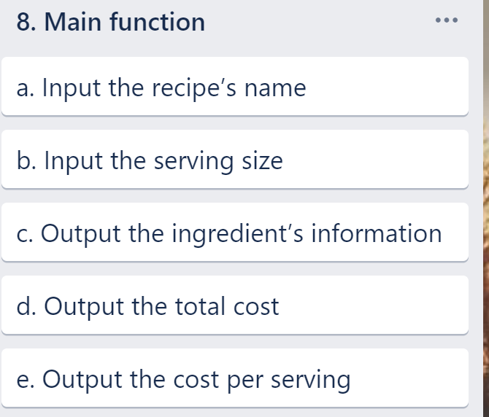

Slide 34
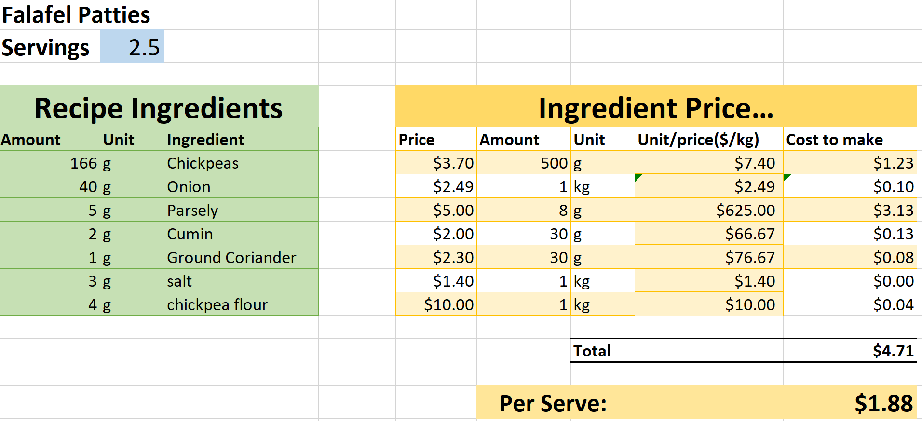
8. Assembled Outcome Test Plan(expected value)
User Input
Calculated output

Slide 35
8. Assembled Outcome Test Plan(unexpected values)
Test Case | Expected
First time? <blank> | <error - choose y / n>
First time? Maybe? | <error - choose y / n>
First time? Yes | <continues, shows instructions>
Recipe name? <blank> | <error - can’t be blank>
Recipe name? Falafel Patties4 | <error - has number in it>
Recipe name? Falafel Patties | <continues>
Serving size? <blank> | <error - input number>0>
Serving size? Egg | <error - input number>0>
Serving size? 0 | <error - input number>0>
Serving size? 2.5 | <continues>

Slide 36
8. Assembled Outcome Test Plan(unexpected values)
Ingredients name? <blank> | <error - can’t be blank>
Ingredients name? xxx | <error - at least one item>
Ingredients name? Chickpeas4 | <error - has number in it>
Ingredients name? Chickpeas | <continues>
Amount of ingredients? <blank> | <error - input number>0>
Amount of ingredients? Egg | <error - input number>0>
Amount of ingredients? 0 | <error - input number>0>
Amount of ingredients? 166 | <continues>
ingredients unit? <blank> | <error - need either g or kg>
ingredients unit? Meter | <error - need either g or kg>
ingredients unit? G | <continues>
ingredients listing price? <blank> | <error - input number>0>
ingredients listing price? Egg | <error - input number>0>
ingredients listing price? 0 | <error - input number>0>
ingredients listing price? 3.7 | <continues>
ingredients listing weight? <blank> | <error - input number>0>
ingredients listing weight? Egg | <error - input number>0>
ingredients listing weight? 0 | <error - input number>0>
ingredients listing weight? 500 | <continues>
ingredients unit? <blank> | <error - need either g or kg>
ingredients unit? Meter | <error - need either g or kg>
ingredients unit? G | <continues>
Repeat this format to input an ingredient with kg
Verify the output

Slide 37
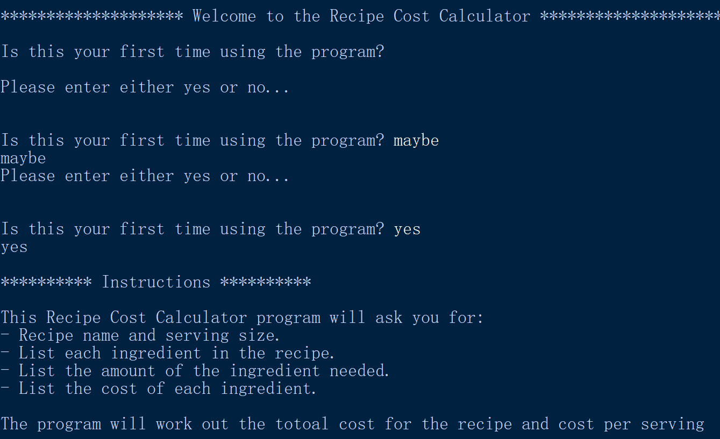
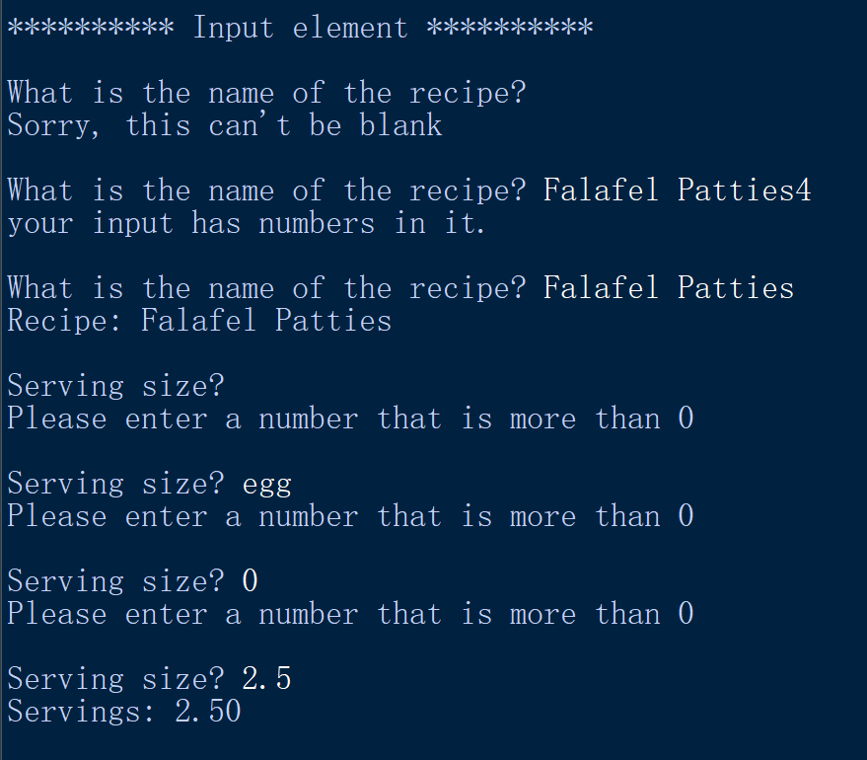
8. Assembled Outcome testing

Slide 38
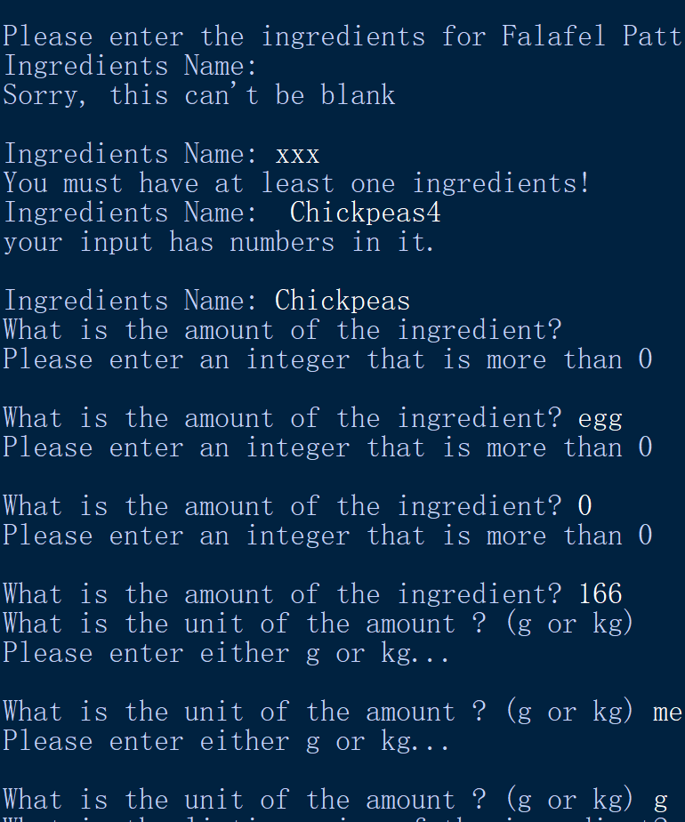
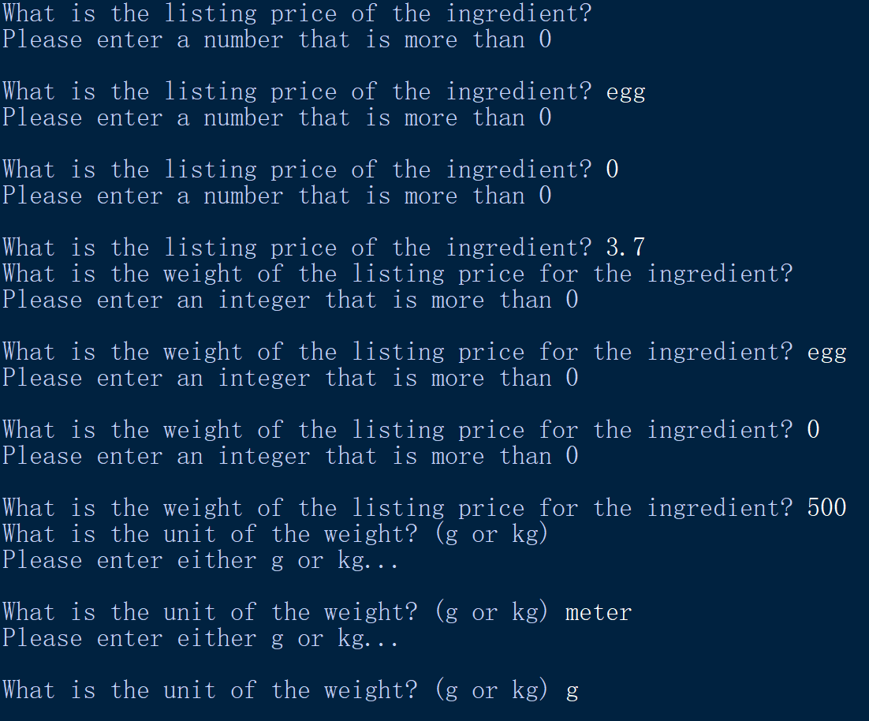
8. Assembled Outcome testing

Slide 39
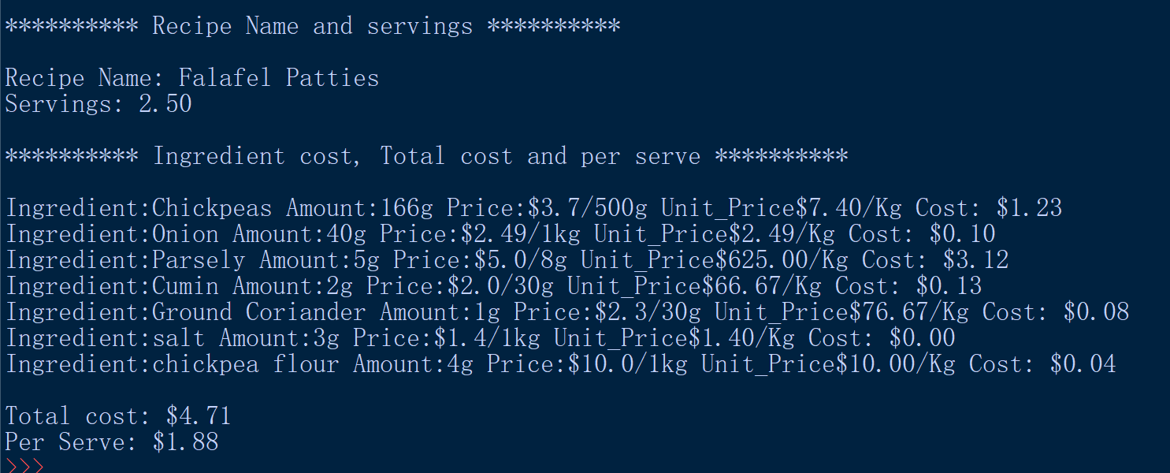
8. Assembled Outcome testing

Slide 40
8. Assembled Outcome Test Plan - Trialling Notes
The goal of this testing is to confirm that the components have been successfully added to the main program and the functions have been correctly called at each point.
It also need to verify all the calculations in the sub function and in the main function are correct
In the previous sub-function test, I found I forgot to test the blank input for the valid number checker, valid name checker, yes no checker and unit checker. I add it to the final test.

Slide 41
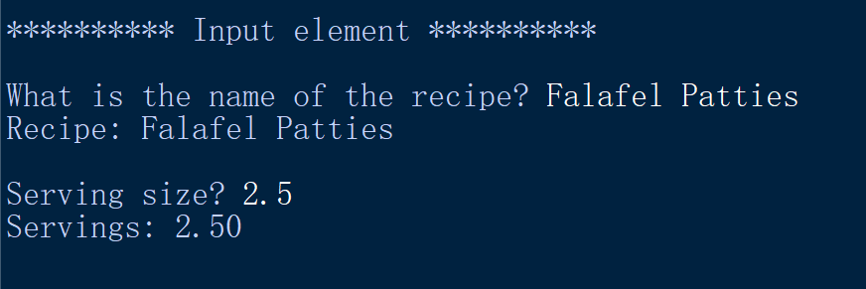
Usability Testing
In the previous version, there is no lines to indicate which information is input and which one is calculated. Later version I add *****input element***** to show it

Slide 42
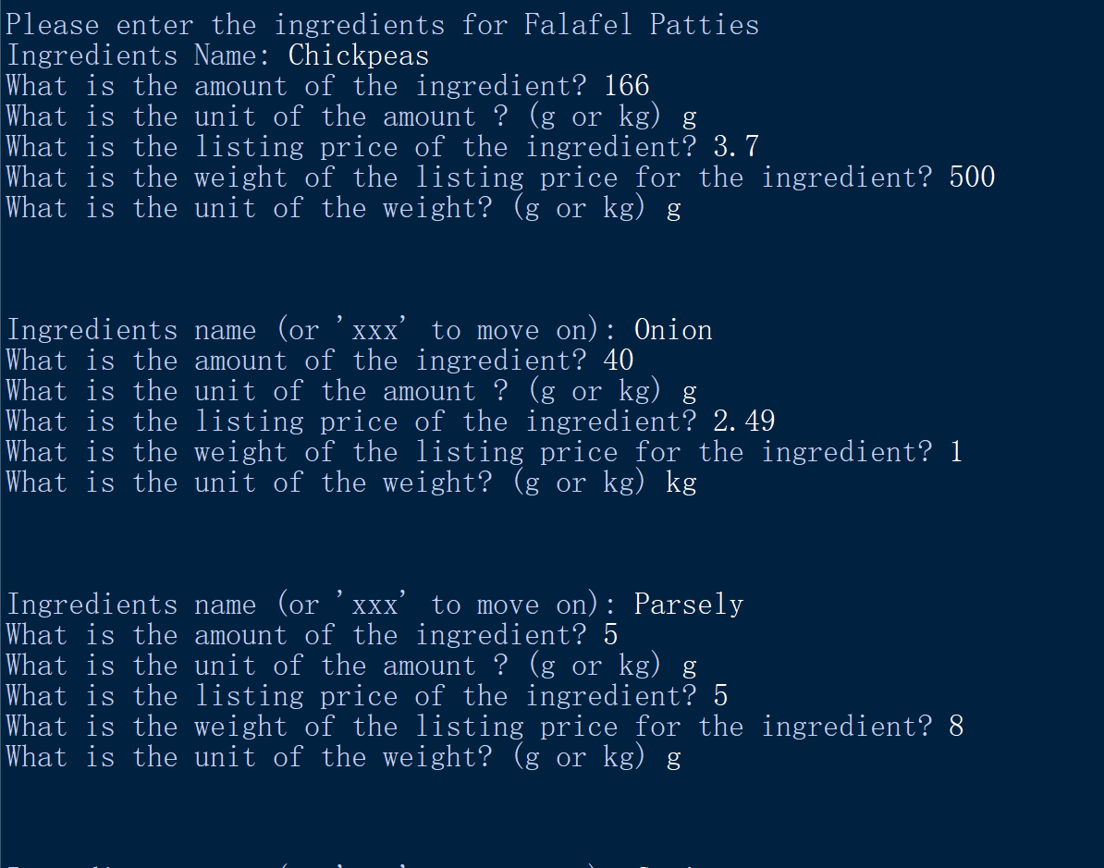
Usability Testing
In the first version of get ingredients, there is no blank paragraph between different ingredient information. It is difficult to have a clear view of my input. Later version add more paragraph between each ingredient

Slide 43
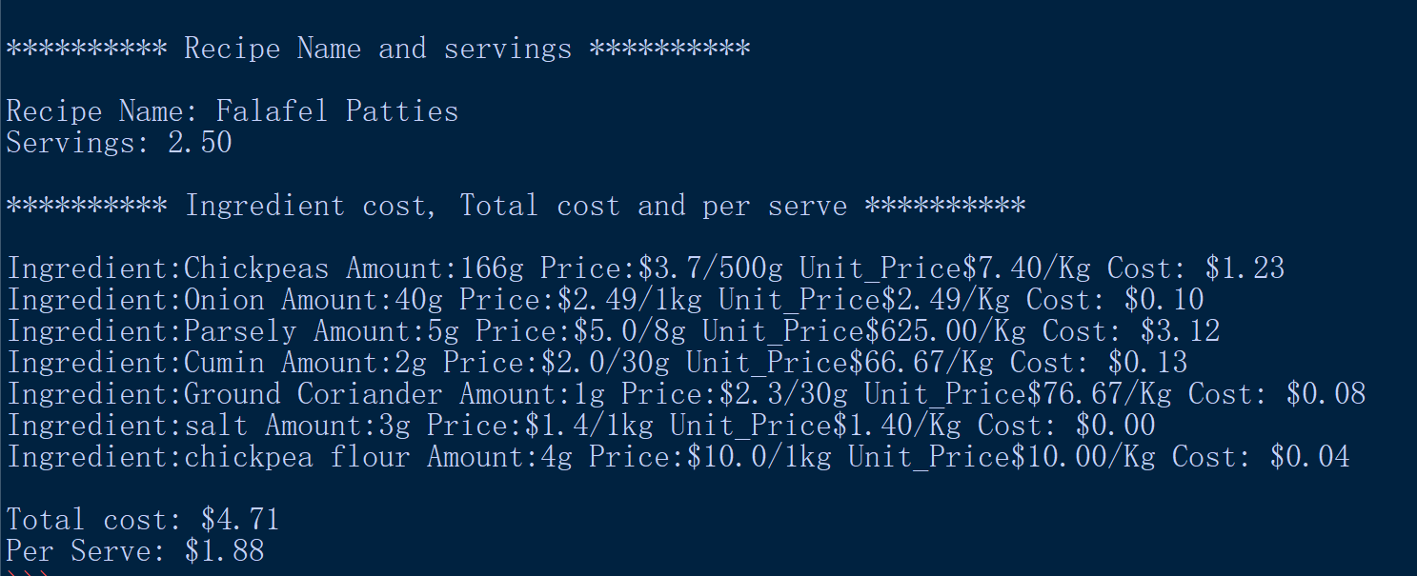
Usability Testing
In the first version it only print out the Recipe Name, Servings, total cost and per Serve. Also it has no line to separate the item. The last version I add more ***** line to explain the content and also print the ingredient information as a reference.

Slide 44
Discuss how the information from planning, testing and trialling of components assisted in the development of a high-quality outcome.
I used a word document and Trello board to plan my project. I listed the break down componet in the word document and then copy this to the Trello board. Word document give more flexibility and easier editing when I thinking how the program shoud structure. In the trello board the user can set a due date and the complete or not complete status on that. So in the trello board it can give more convinient to controll the development schedule

